Slide 1

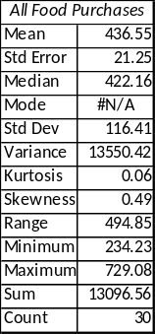
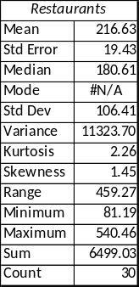
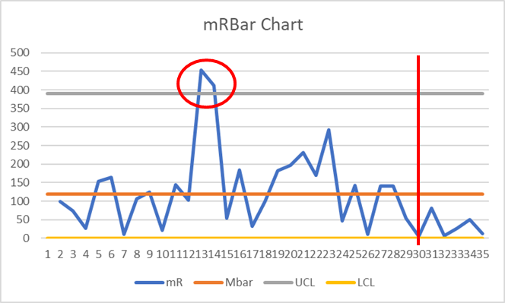
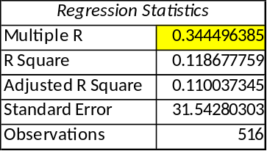
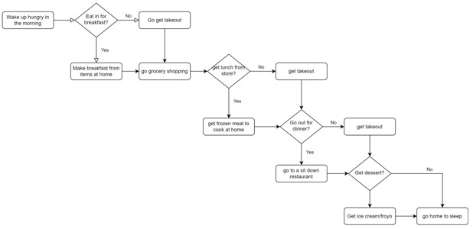
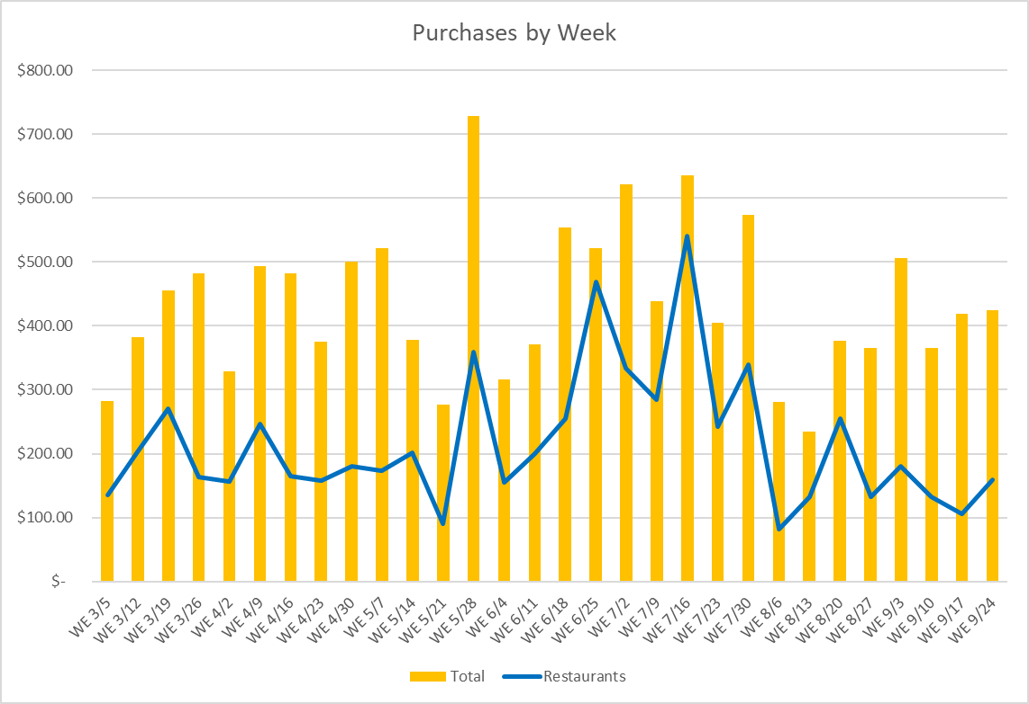
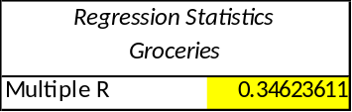
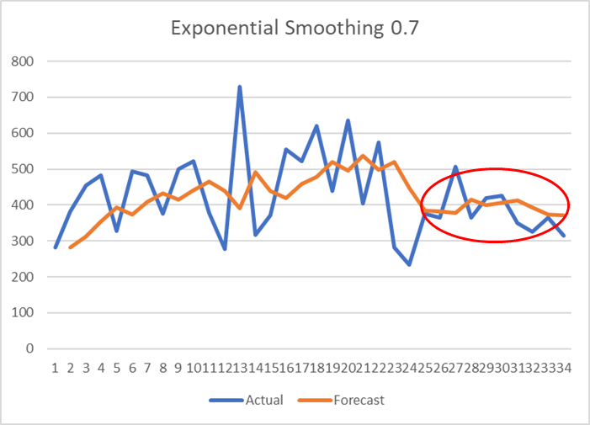
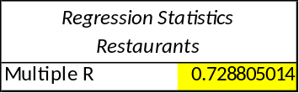
Reducing Food Expenditures
Process owner: Richard Sangster
Key Dates --->
Start
10/6
Define
10/6
Measure
10/10
Analyze
10/24
Improve
11/7
Control
11/28
DEFINE
MEASURE
ANALYZE
IMPROVE
Descriptive Statistics
Multiple Regression
Out of control data point
Problem Statement: With the increase in housing costs, the goal of this project is to decrease consumable expense by $50 a week to counteract this.
Moderate predictor
Correlation
New SQL : 2.8
The mean restaurant cost per week is about $216. The mean cost total is $436. It appears that as the restaurant cost increases so does the total cost.
CONTROL
Restaurants more correlated to total
SQL : 2.5
Forecast initially is increasing but eventually drops at 25.
Initial thoughts for the large amounts of money going towards food is linked to going out to eat. Which places are causing this is something we consider to be an important part of the equation.
Restaurants v. Total

